Slide 1

Scheduling in Smart Grids
Arun Srikanth, Divya Pathak, Harsha Panjwani and Varun Pillai
OPR-922/620 Winter 2015
March 18, 2015

Slide 2
What is Smart Grids ?
An optimal energy scheduling policy that considers the varying demands in a particular residential neighborhood as well as minimizes the total cost which is necessary in the present situation where global energy resources are limited

Slide 3
Outline
Electric appliance scheduling
Individual home
Individual home with power capacity constraints
Residential neighborhood
Conclusions

Slide 4
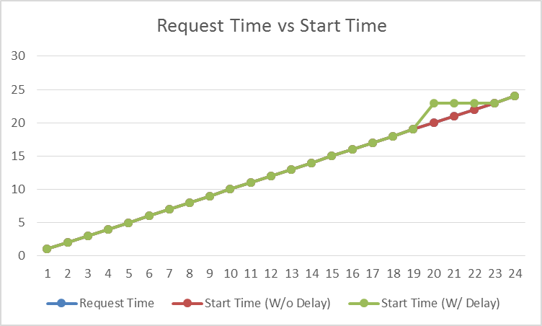
Base case Scenario

Slide 6
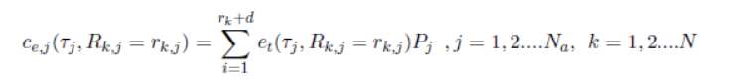


Cost functions

Slide 7

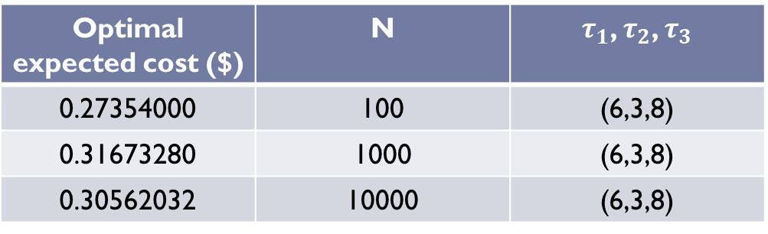
Optimal expected cost ($) | N | $τ_{1}$, $τ_{2}$, $τ_{3}$
0.27354000 | 100 | (6,3,8)
0.31673280 | 1000 | (6,3,8)
0.30562032 | 10000 | (6,3,8)

Slide 8


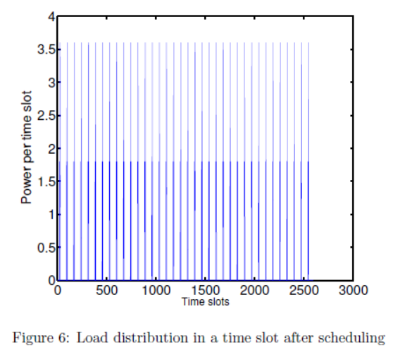
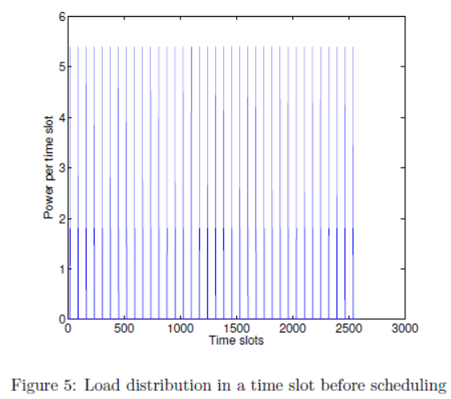
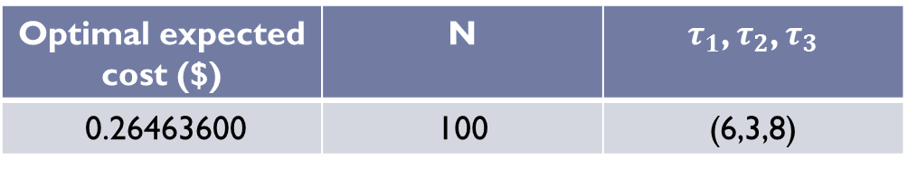
Optimal expected cost ($) | N | $τ_{1}$, $τ_{2}$, $τ_{3}$
0.26463600 | 100 | (6,3,8)

Slide 9
Scheduling Power in a Residential Neighborhood
EMC
EMC
EMC
Power Grid
EMC
EMC
Set of appliances
EMC
EMC
EMC
Home
15 Homes with 3 appliances each
All homes are identical
EMCs can communicate between each other

Slide 10
Power Optimization
Objective : Maximize Quality of Service (QoS)
An ON request from any appliance must be granted in the 48 hour time interval (T)
Constraints: Power consumption by the neighborhood in time T is below a threshold (P_{max}) set by the Electric company
Assumptions
Each appliance is turned ON only once in time T
EMCs can borrow power from each other
No power limit set per home
No significant saving in optimizing power consumption cost based on the electricity cost per time interval

Slide 11
EMC Tool Developed
Determine optimal P_{max} (105 kW)
For the given data P_{max} is obtained as the average of 1000 random scenarios for appliance request time and duration
Optimize appliance scheduling within time T with total power consumption below P_{max}
Costing done per home by including power borrowed from neighbors

Slide 12
Appliance Scheduling
Scheduling with total power consumed ≤ P_{max}
Zero delay
100 % QoS

Slide 13
Appliance Scheduling
Suggested scheduling by lowering power threshold below P_{max}
Trade off between power consumed and QoS

Slide 14
Conclusions
Power grid scheduling model
Non Linear Integer Programming Model developed
Power cost savings for home user
Optimized level load across neighborhood level
Benefits
Customer
Utility Company

Slide 15
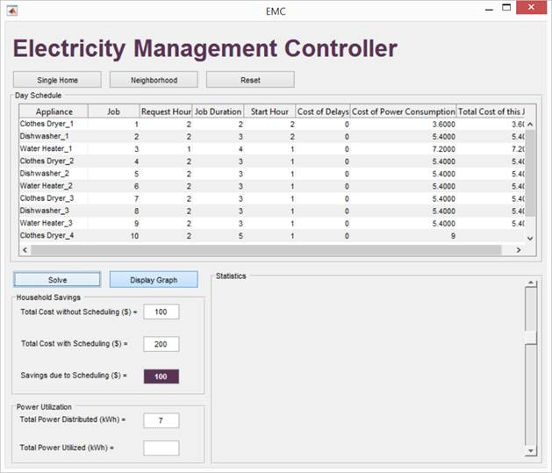
Application

